Slide 1
Graph Theory
An Introduction to the History

Slide 2
Definition
Graph theory is defined as the:
  Mathematical study of the structures of abstract relationships between objects (Andersen, 2011).
  Study of graphs, mathematical structures used to model pairwise relations between objects. A graph in this context is made up of vertices, nodes, or points which are connected by edges, arcs, or lines (“Introduction to Graph Theory”, 2016).
  Graph theory notation is G=(V,E), where v represents the vertices of the graph, and e represents the edges of the graph.

Slide 3
The beginning
“The origins of graph theory are humble, even frivolous. Whereas many branches of mathematics were motivated by fundamental problems of calculation, motion, and measurement, the problems which led to the development of graph theory were often little more than puzzles, designed to test the ingenuity rather than to stimulate the imagination. But despite the apparent triviality of such puzzles, they captured the interest of mathematicians, with the result that graph theory has become a subject rich in theoretical results of a surprising variety and depth” (Biggs, Lloyd, & Wilson, 1976).

Slide 4
Which problem came first?
Many mathematicians have debated which publication came first.
One publication solved the problem of the Knight’s Tour
The other publication solved the problem of the Königsberg Bridges
Each of these problems has been considered the origin of graph theory (Alexanderson, 2006).

Slide 5
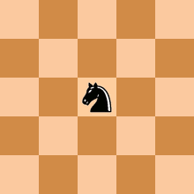
Knight’s Tour
Definition of the Knight’s Tour: The knight is placed on the first block of an empty board and, moving according to the rules of chess, must visit each square exactly once (“The Knight's tour problem”, 2018).
The problem is to find a Knight’s Tour.
Euler used an 8x8 chess board.
An open knight’s tour is one where the tour ends on a square one move away from the beginning square, thus making it possible to do the tour again. Otherwise, it is closed.
Open Knight’s Tour on 5x5 Grid

Slide 6
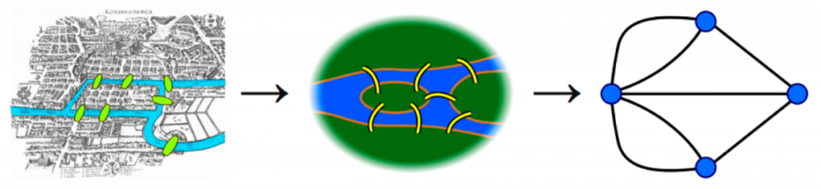
Königsberg Bridges
Königsberg consisted of four islands connected by seven bridges.
The problem: Could a person devise a path through Königsberg so that one could cross each of the seven bridges only once and return home (Alexanderson, 2006)?
Euler did not use modern graph theory to solve this puzzle. He used logic.

Slide 7
Summary
In the end, graph theory became a subject of interest because it was a way to solve puzzles or problems long thought to be impossible. It also developed into being able to model real-life behavior of an event.
It is still an ongoing field of discovery. So go out there, learn some more, and get interested in research.

Slide 8
References
Alexanderson, G. (2006). About the cover: Euler and Konigsberg’s Bridges: A historical view. Bulletin of the american mathematical society, 43(4), 567-573.
Andersen, A. (2011). GraphShop: An interactive software environment for graph theory research and applications.
Biggs, N. L., Lloyd, E. K., & Wilson, R. J. (1976). Graph Theory 1736-1936, 1976.
Hopkins, B., & Wilson, R. J. (2004). The truth about Konigsberg. The College Mathematics Journal, 35(3), 198-207.
  Introduction to graph theory. (2016). Retrieved from https://www.ebi.ac.uk/training/online/course/network-analysis-protein-interaction-data-introduction/introduction-graph-theory
  The Knight's tour problem. (2018). Retrieved from https://www.geeksforgeeks.org/the-knights-tour-problem-backtracking-1/)

